Slide 1
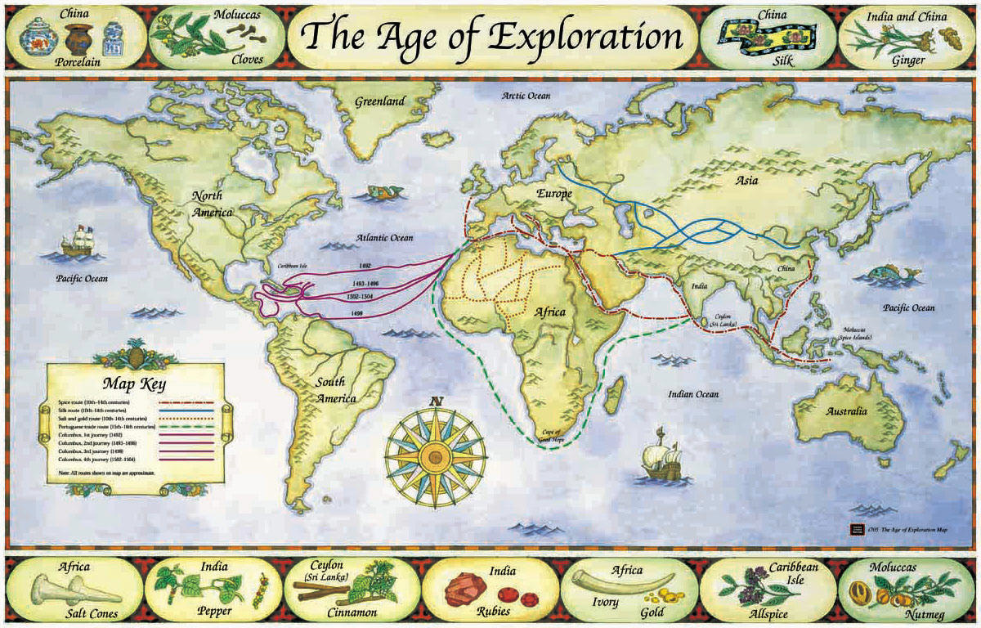

Slide 2
AGE OF EXPLORATION & COLONIZATION
* DURING THE LATE 1400s, FOUR NATIONS BEGAN LOOKING FOR NEW ROUTES TO THE FAR EAST. REASONS INCLUDE:
1. Land routes were too dangerous, and often excessive fees were demanded.
2. The Renaissance gave mankind a new sense of adventure, due largely to the influence of PRINCE HENRY THE NAVIGATOR.
3. New navigational equipment developed (astrolabe & compass); cartography (the art of map making) became much more accurate than previously; sailors began using charts from Arab navigators, etc.
4. International rivalries, as nations fought for more territory.
5. The Adventures of Marco Polo spurned interest in the trade items of the Far East. He visited CATHAY (modern day China) in 1200s.

Slide 3
* The Portugese were the first to search for an all-water route to the far east in 1488.
* Bartholomeu Dias
was not successful,
but provided valuable info for
later travel.
* In May of 1498, Vasco De Gama reached India.

Slide 4
VOYAGES TO AMERICA, 1500-1700
* FOLLOWING PORTUGAL’S SUCCESS, THREE OTHER POWERFUL EUROPEAN NATIONS BEGAN THEIR OWN SEARCHES BY GOING IN A WESTWARD DIRECTION:
SPAIN, FRANCE AND ENGLAND.
* FIRST, IN 1492, AN ITALIAN, CHRISTOPHER COLUMBUS PERSUADED QUEEN ISABELLA OF SPAIN TO FINANCE A VOYAGE IN A WESTWARD DIRECTION.
* IN 1492, HE REACHED THE COASTLINE OF CUBA.

Slide 5
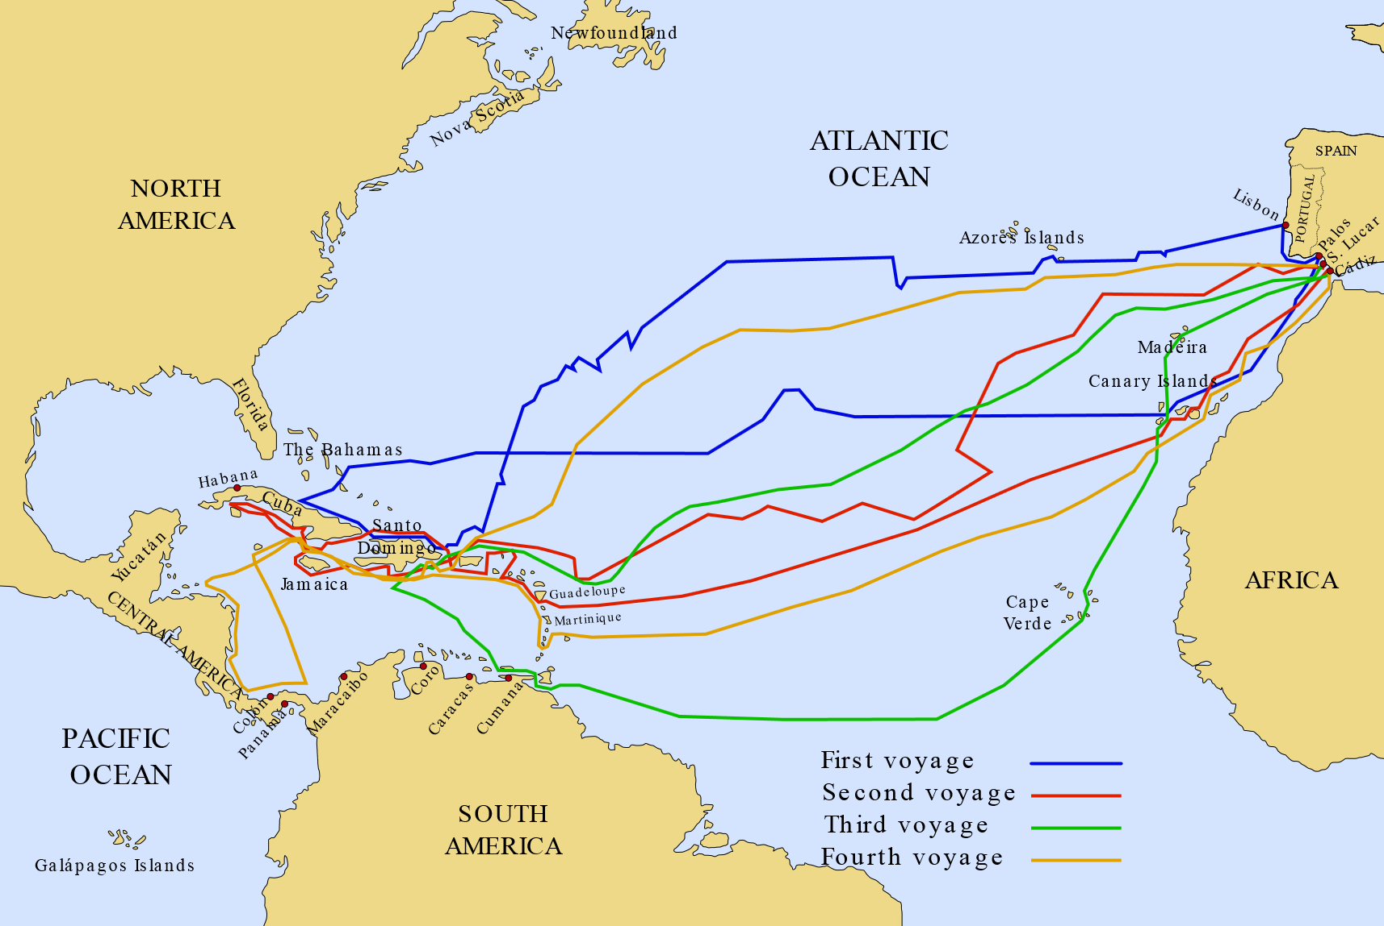

Slide 6
EUROPEAN RACE TO THE AMERICAS
* Other explorers soon realized that Columbus had discovered
an entirely new continent.
* Portuguese sea captain AMERIGO VESPUCCI, a Florentine, went along on several voyages to the new world, and wrote letters describing what he saw. These letters led to the use of the name AMERICAS for the new lands.
* The race to establish colonies in these new lands began:
Spain – claimed islands in Caribbean, West Indies, S.A. and N.A.
England – claimed land up and down Atlantic Coast and Canada.
France – claimed the interior of N.A. and islands in Caribbean.
Portugal – claimed Brazil.

Slide 7
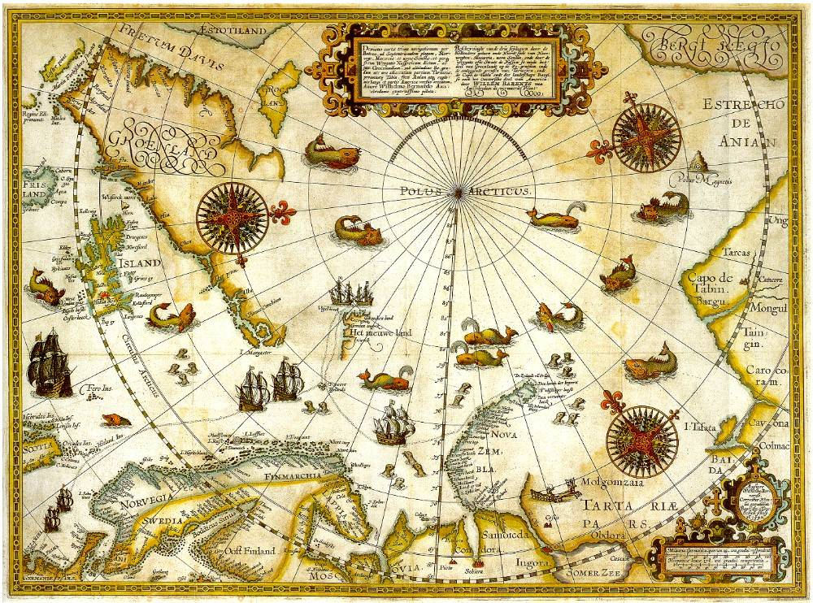

Slide 8
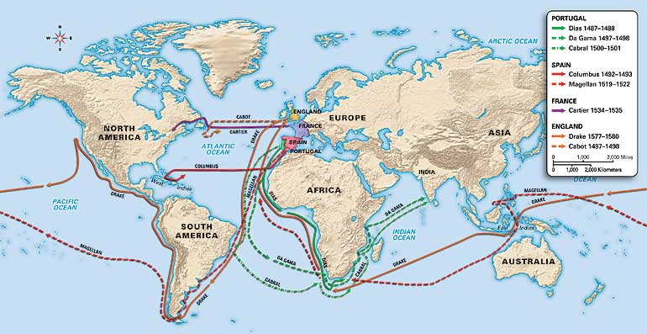

Slide 9
THE TRIGULAR TRADE ROUTE
* AS MORE NATIONS BECAME INVOLVED IN
EXPLORATION OF THE NEW WORLD, THERE
GREW A TEMENDOUS
AMOUNT OF TRADE BETWEEN THE OLD AND
NEW WORLDS.
BOTH BENEFITTED IN SOME WAYS, BUT DUE
TO UNEQUAL MILITARY POWER AND WEALTH,
THE NEW LANDS SOON BECAME MAJOR AREAS OF EXPLOITATION AND
DESTRUCTION OF THEIR WAY OF LIFE.

Slide 10
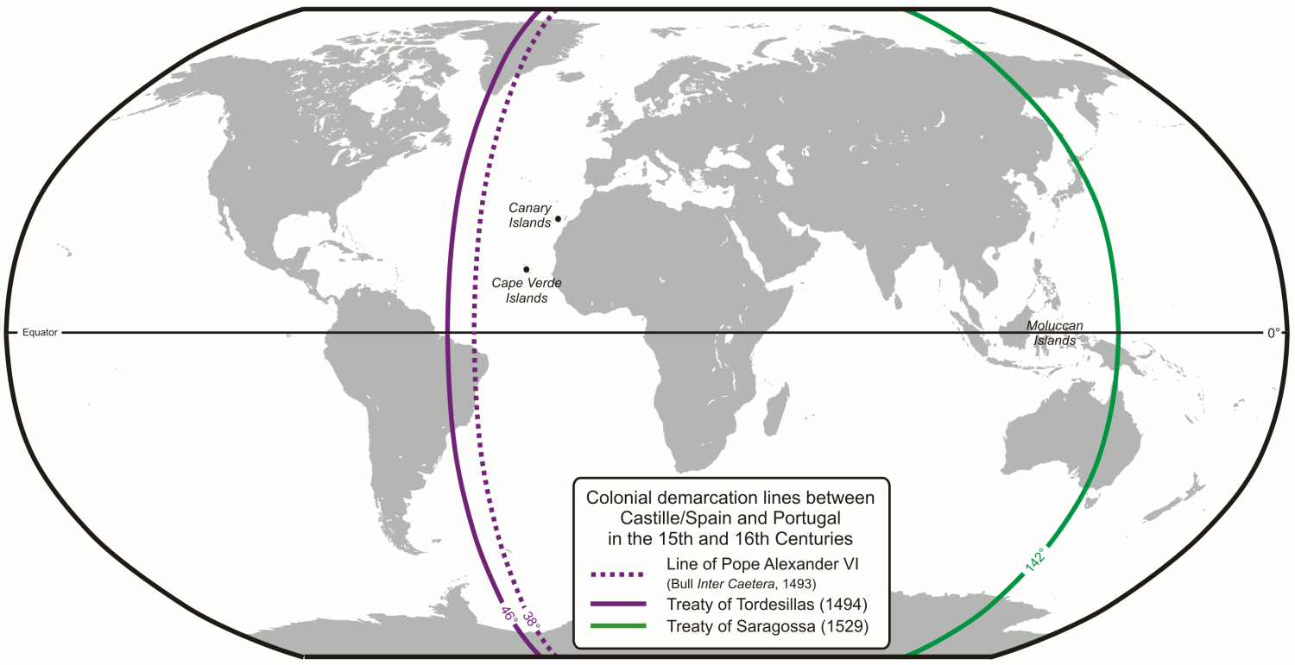

Slide 11
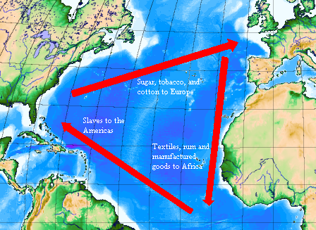

Slide 12
THE MIDDLE PASSAGE & SLAVE TRADE
* SLAVERY WAS NOT NEW TO AFRICAN NATIONS, BUT WITH THE CREATION OF HUGE SUGAR CANE, COTTON AND TOBACCO PLANTATIONS IN NORTH AND SOUTH AMERICA, THE TRADE EXPLODED.
* IN 1515, THE PORTUGESE TRANSPORTED THE FIRST GROUP OF SLAVES TO BRAZIL, AND TO ISLANDS IN THE CARRIBBEAN, TRANSPORTING AROUND 250,000.
* THIS BEGAN A NEW WORLD ECONOMY, IN WHICH AS MANY AS TEN MILLION SLAVES WERE BROUGHT TO THE AMERICAS BETWEEN 1500 AND 1800.
* THE TERM MIDDLE PASSAGE IS USED TO DESCRIBE THIS.

Slide 13
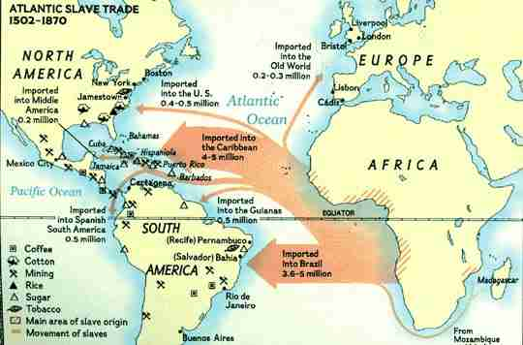

Slide 14
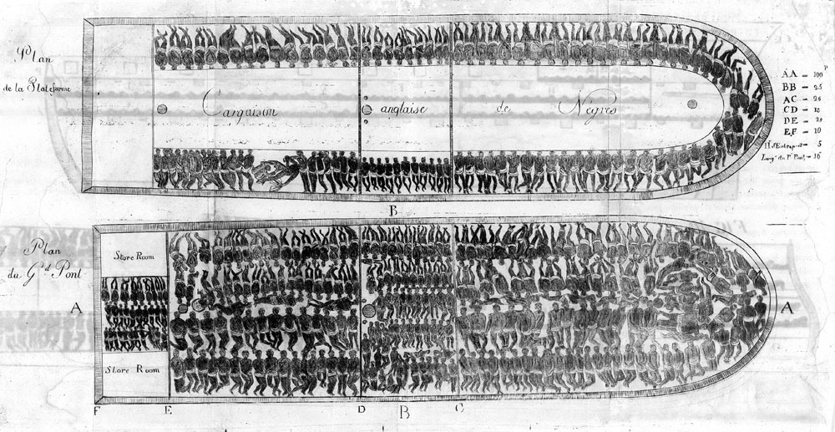

Slide 16
THE ASIAN SPICE TRADE & EFFECTS
PORTUGESE INFLUENCE
THE DUTCH ARRIVE
* The theory of mercantilism dominated economic though during the 1600s.
* According to this theory, the prosperity of a nation depended on a large supply of gold and silver.
* To bring in gold and silver, nation needed to have a favorable balance of trade.
The Portuguese dominated trade during the 1500s in Southeast Asia, the Spice Islands.
* In the early 1600s, the Dutch arrived, and soon established both political, economic and military power.
* The English were driven out by the Dutch.

Slide 17
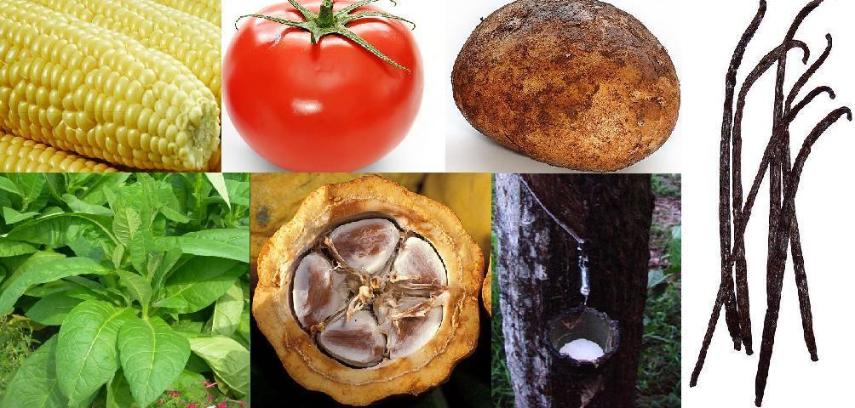
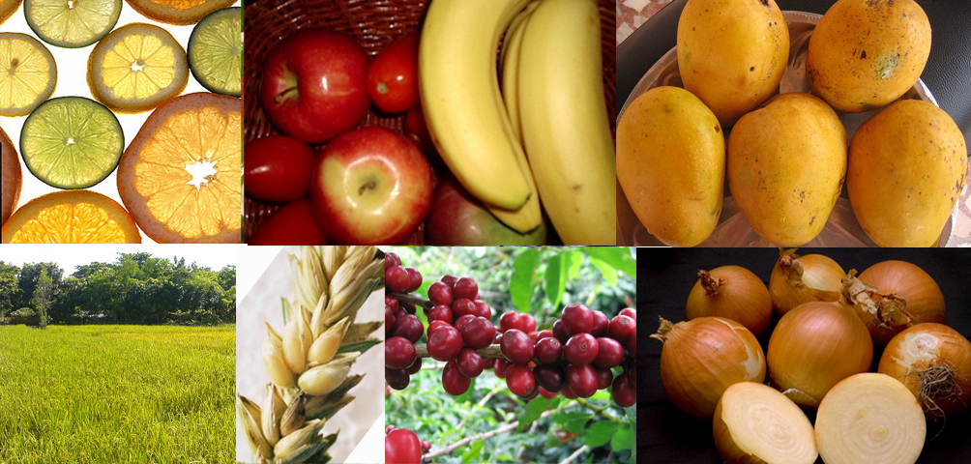
New World
Old World

Slide 18
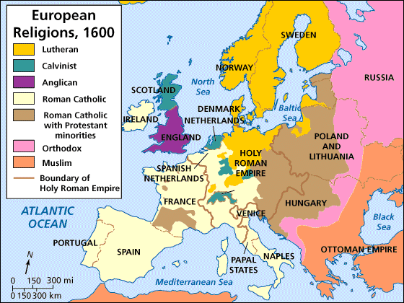

Slide 19
EFFECTS O EXPLORATION/COLONIZATION
* Produced a new age of commercial capitalism that was one of the first steps toward today’s world economy.
* Introduction of slavery continues to impact today.
* Contributed to a transfer of ideas and products.
* Creation of international trade markets.
* Diverse religious philosophies introduced to the New World.
* Contributed to international rivalries, which led to military conflicts in the old and new worlds.
* The decimation of native american tribes due to introduction of European diseases for which they had no immunity.

